Slide 1

ADP PrOJECT MID-PROGRESS evaluation
<<Smart Contact Manager>>
Supervised By: Prof. Lakshmisree Panigrahi
Group No.#: 14
Priyansu Padhy: 2141016013
Bibhab Ranjan Panda: 2141016071
Amit Parida: 2141016128
P.Padmaja Patra: 2141016197
Department of Computer Science and Engineering
Faculty of Engineering & Technology (ITER)
Siksha ‘O’ Anusandhan (Deemed to be) University
Bhubaneswar, Odisha
1

Slide 2
Presentation Outline
Introduction
Motivations
Uniqueness of the work
Literature Survey
Existing System
Problem Identification
Schematic Layout Or ER diagram
Methods OR Tools OR Algorithms used
Experimentation and Results
System/Model Specifications
Screenshots
SpringBoot features used
Experimental outcomes (Tables and Figures)
Result Analysis
Conclusion and Future Scope (Key Findings)
Bibliography
2

Slide 3
Introduction
Overview
A Smart Contact Manager built with Spring Boot is a secure, scalable web application for efficient contact management. It supports CRUD operations, grouping of contacts, and advanced search features, streamlining organization. Key functionalities include secure user authentication and role-based access using Spring Security, encrypted data storage.The app features a responsive, user-friendly UI and integrates with email services for communication and task scheduling. With cloud support and robust database management, it offers scalability and accessibility, making it an indispensable tool for personal and professional contact organization.
3

Slide 4
Introduction contd..
Motivations
Streamlining Contact Management
Centralizes contact organization and management for efficiency.
Enhancing Data Security
Protects sensitive information with encryption and secure authentication.
Improving Productivity
Automates tasks and enables seamless communication for better workflow.
Fostering Better Relationships
Tracks interactions and segments contacts for personalized communication.
Leveraging Scalable Technology
Builds a scalable and reliable application with cloud deployment support.
Addressing Real-World Challenges
Solves issues like disorganized records with advanced search and a responsive UI.
Encouraging Innovation
Utilizes modern frameworks to inspire feature-rich, user-focused solutions.

Slide 5
Introduction contd..
Uniqueness of work
Spring Boot Integration
Utilizes Spring Boot for a scalable, secure, and high-performance application.
Advanced Security Features
Implements encryption, multi-factor authentication, and role-based access for data protection.
Cloud-Ready & Scalable
Supports cloud deployment for remote access and scalability to handle growing data.
Customizable & User-Friendly UI
Provides a responsive and customizable interface for an enhanced user experience.
Real-Time Communication & Automation
Integrates with communication platforms and automates tasks to improve productivity.

Slide 6
Literature Survey
Existing System
Limited Customization
Many contact managers offer limited options for customizing the user interface or categorizing contacts effectively.
Security Vulnerabilities
Some contact managers lack robust security features like encryption and multi-factor authentication, putting sensitive data at risk.
Poor Integration with Other Tools
Many contact managers do not seamlessly integrate with other communication or scheduling tools, leading to fragmented workflows.
Scalability Issues
Existing contact managers may not handle large volumes of contacts or scale effectively as user data grows.
Lack of Automation
Many systems lack automation for tasks like reminders, follow-ups, or updates, reducing productivity and increasing manual work.
6

Slide 7
Literature Survey Contd..
Problem Identification
Inefficient Data Organization - Contact data is often disorganized and spread across platforms.
Lack of Personalization - Limited features for tracking interactions and personalizing communication.
Poor Integration - Inadequate integration with other tools like email and calendars.
Scalability Issues - Difficulty handling large amounts of data or growing user needs.
Manual Processes - Lack of automation for tasks like reminders and updates.
Limited Mobile Access - Many systems are not optimized for mobile use.

Slide 8
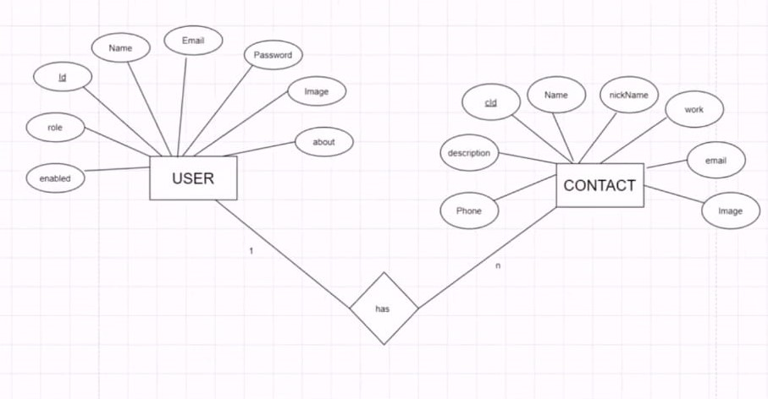
Schematic Layout OR ER Model OR Functional Diagram OR UML Diagram
Schematic Layout
8

Slide 9
Methods OR Tools OR Algorithms used
Methods Used
Technologies and Tools:
Backend: Spring Boot.
Frontend: Thymeleaf , HTML, CSS, JS
Database: MySQL.
Key Methods Used:
Utilizing relational databases (MySQL) to store and organize contact data securely.
CRUD operations for managing contacts and their credentials.
Real-time updation of contacts.
Implements a mobile-friendly and customizable UI using technologies like Thymeleaf to enhance user experience.
9

Slide 10
Experimentation and Results
System Specifications
1) Backend Framework:
Spring Boot (REST API)
Modules: Spring Web, Spring Data JPA, Spring Security, Spring DevTools
2) Database:
MySQL
ORM: Hibernate (JPA)
3) Frontend:
Framework/Library: Thymeleaf for server-side rendering.
HTML and CSS

Slide 11
Experimentation and Results
System Specifications
4) Tools:
IDE: STS (Spring Tool Suite) / Eclipse
Build Tool: Maven
Version Control: Git (e.g., GitHub)
Testing Tools: Junit
5) Runtime Environment:
JDK 17+
Tomcat Embedded Server (Default in Spring Boot)

Slide 12
Experimentation and Results
System Specifications
6) Dependencies:
Spring Boot Dev Tools
Spring Web
Spring Data JPA
MySQL Driver
Spring Security
Thymeleaf
Bean Validation with Hibernate Validator

Slide 13
Experimentation and Results Contd..
SpringBoot Features used
Auto-Configuration
Spring data JPA and Spring security
Thymeleaf Integration
Dependancy Injection using annotations like @Service, @Repository and @Autowired annotations
RESTful endpoints:@RestController and @RequestMapping annotation
Validation:Bean validation annotations like @NotNull,@Size and @Email can be used to validate user inputs before processing
Lombok Integration:like @Getter,@Setter which reduces boilerplate code
Configuration Management :Externalized configuration in application.properties
CRUD Operations

Slide 14
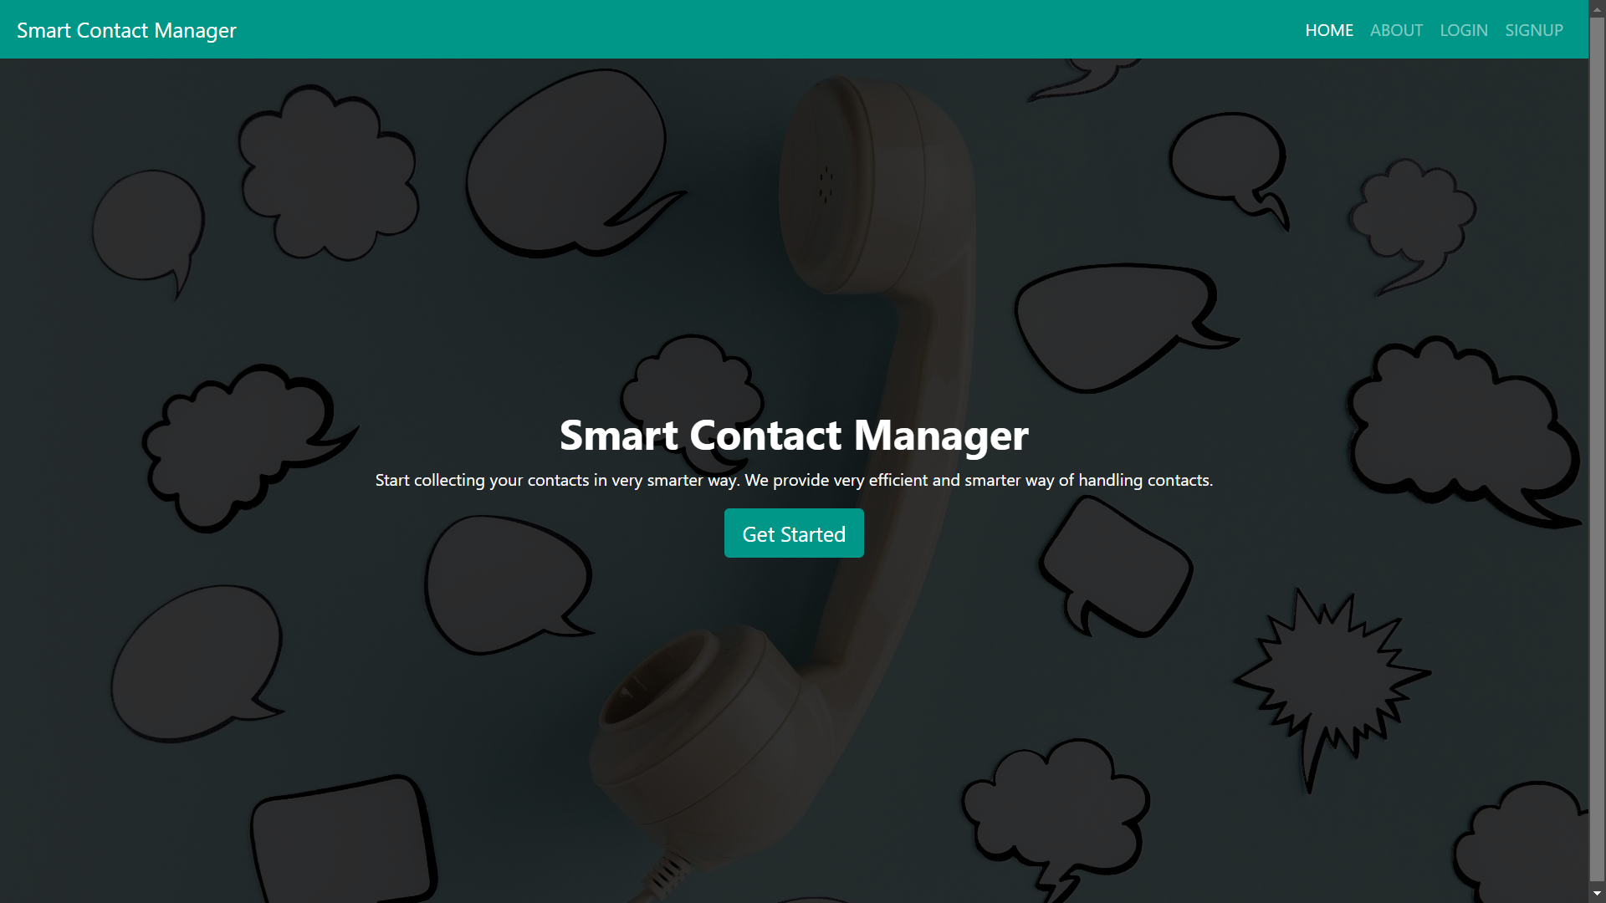
Screen Shots
Home Page

Slide 15
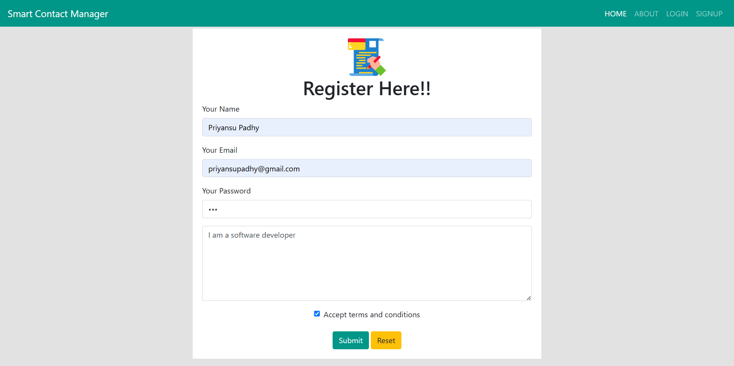
Screen Shots
Registration Page

Slide 16
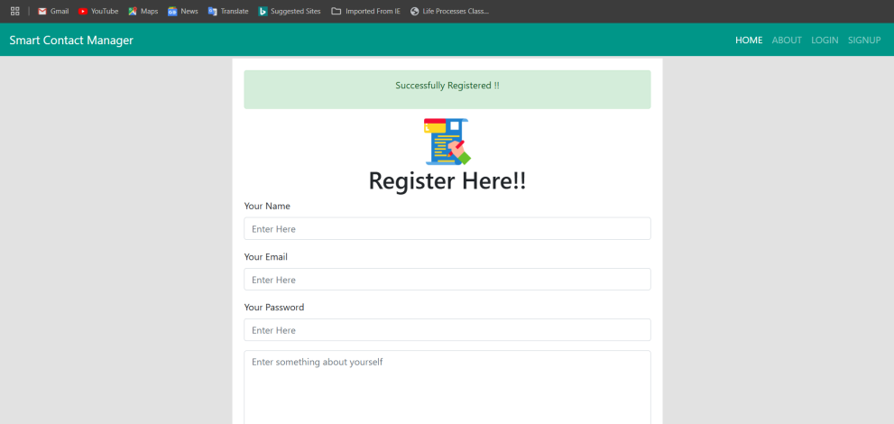
Screen Shots
Registration Successful

Slide 17
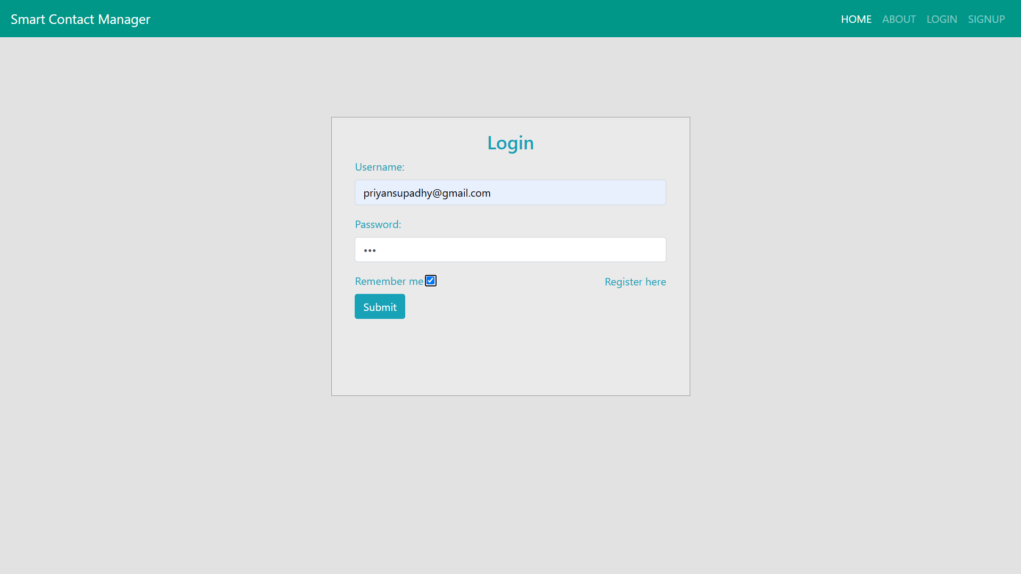
Screen Shots
Login Page

Slide 18
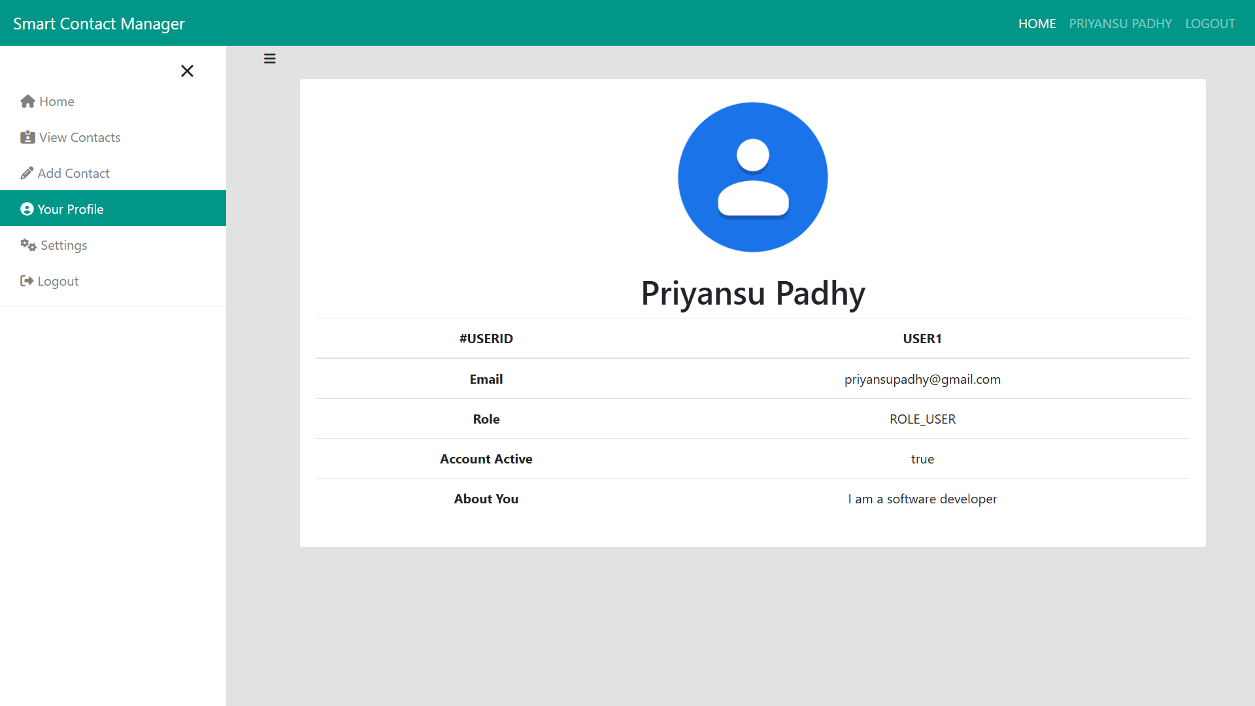
Screen Shots
User Profile

Slide 19
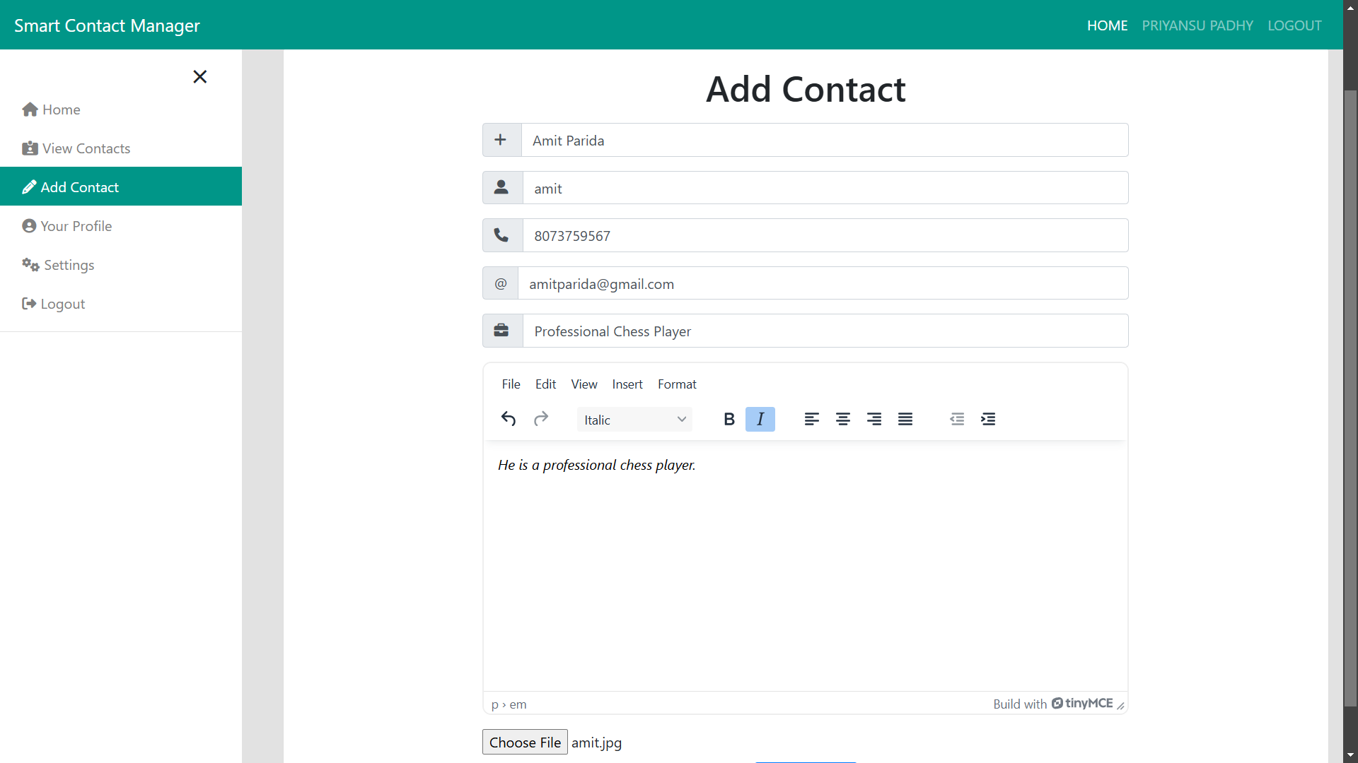
Screen Shots
Add Contact

Slide 20
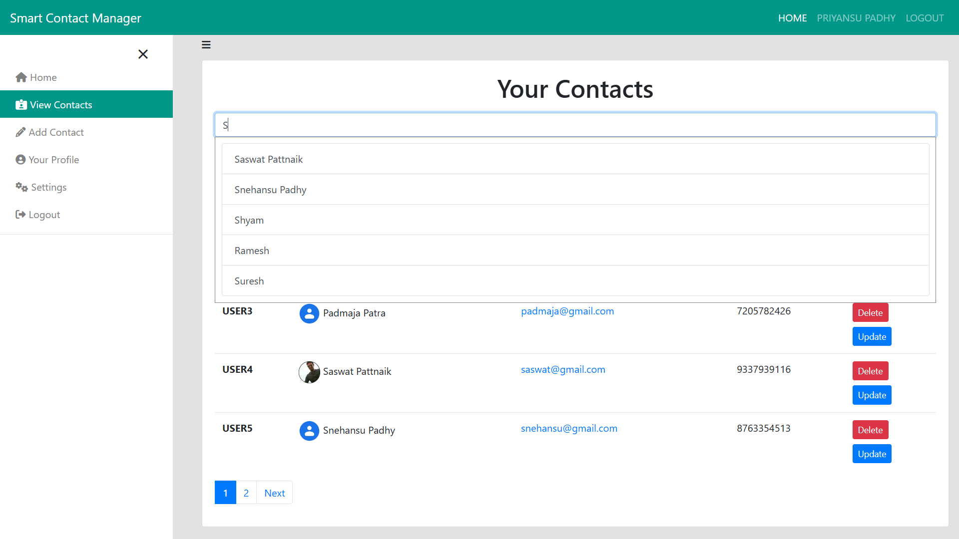
Screen Shots
Search Contact

Slide 21
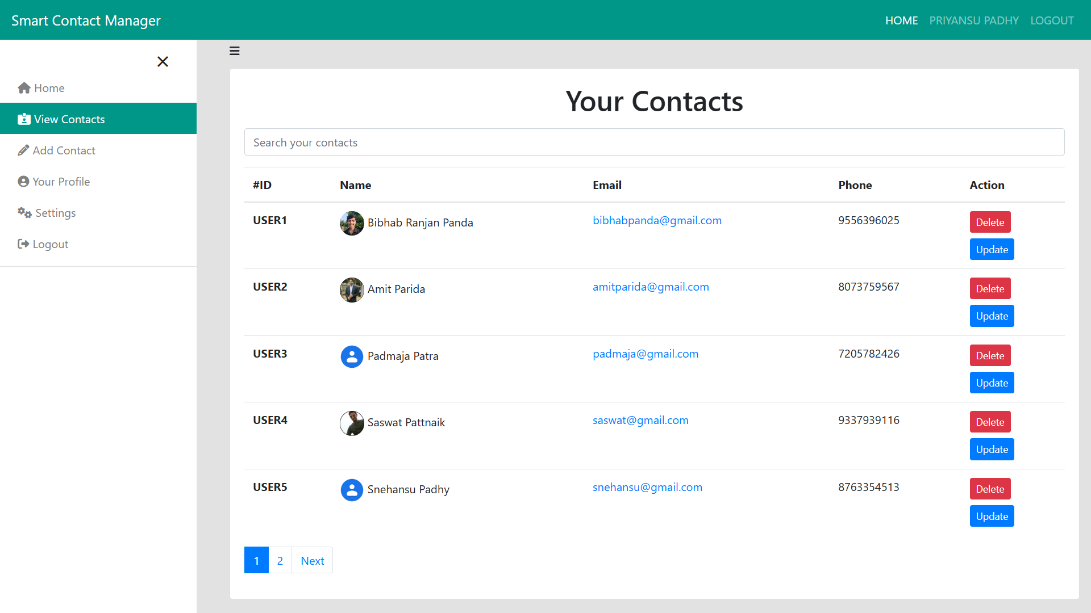
Screen Shots
Contact Preview

Slide 22
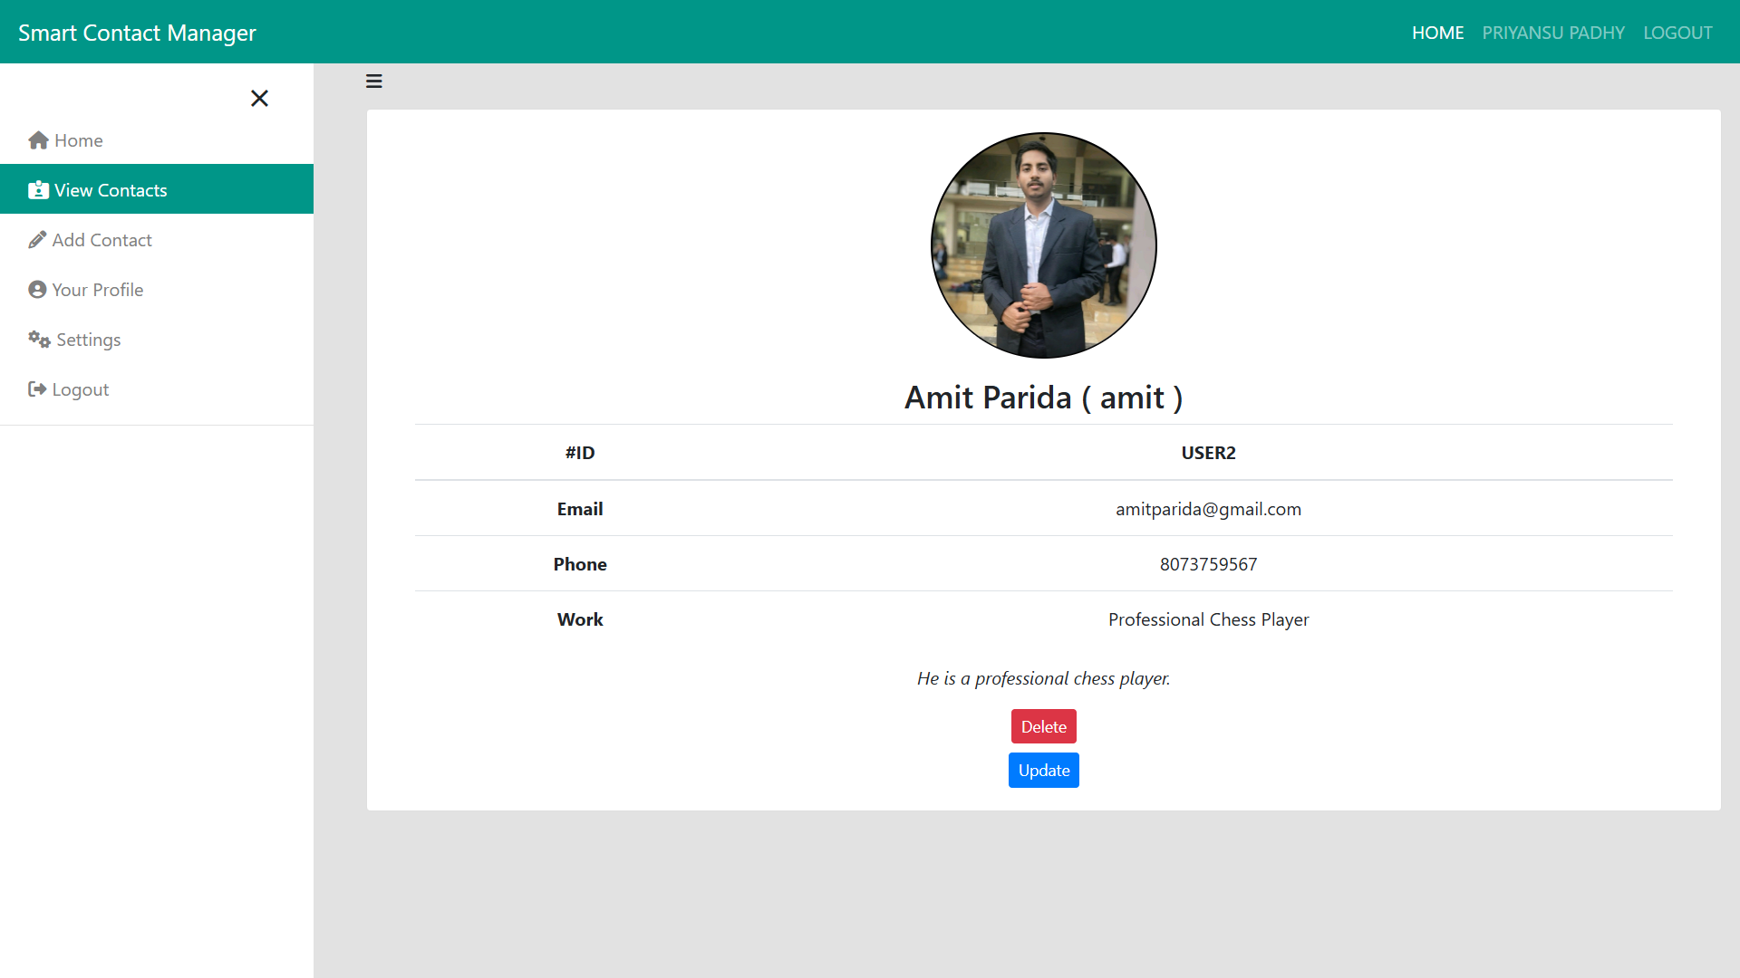
Screen Shots
Detailed Contact Info

Slide 23
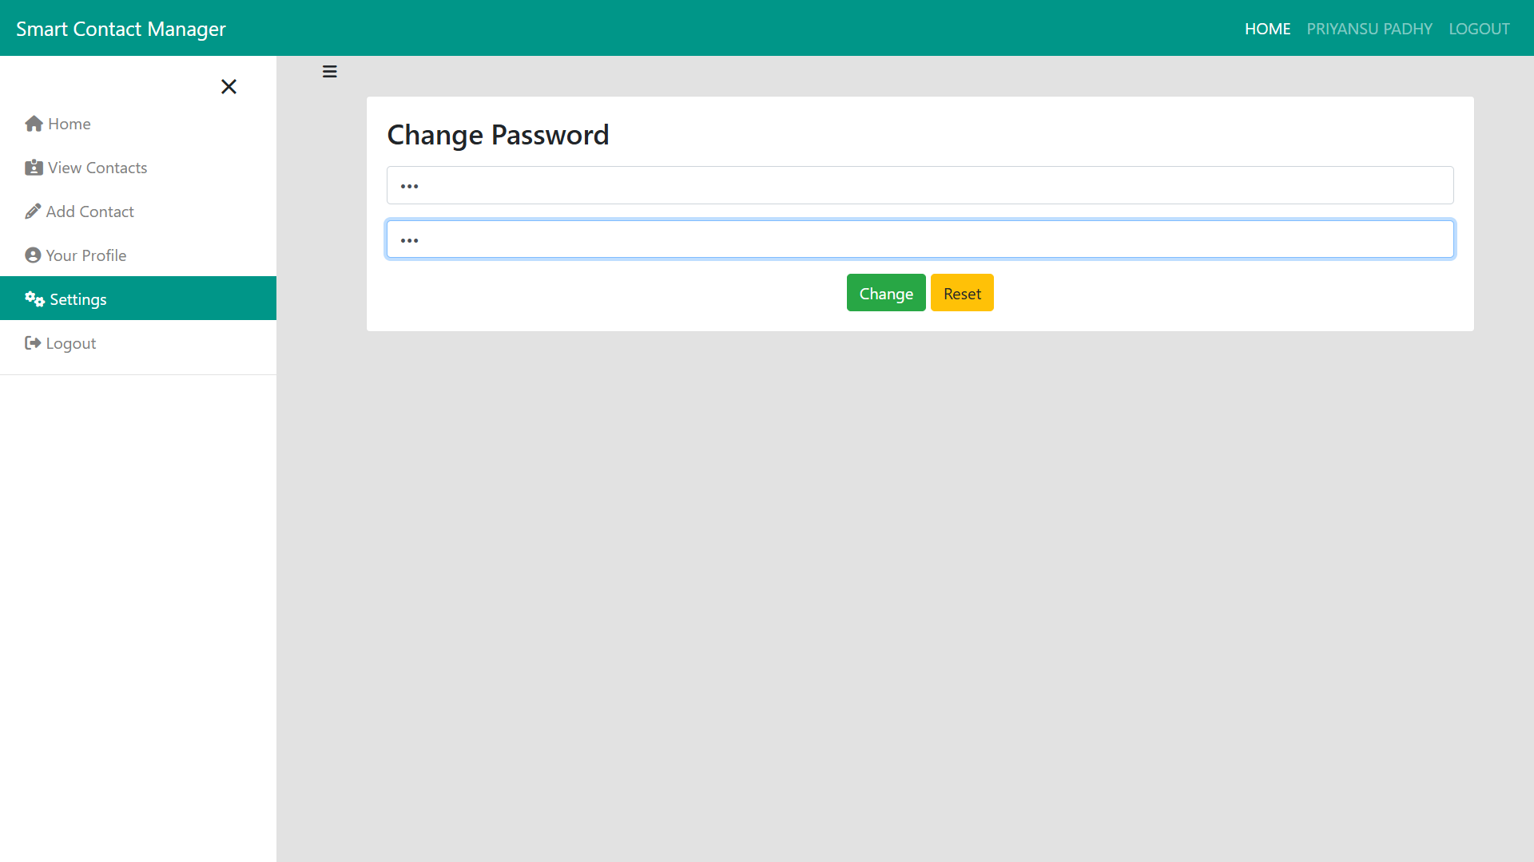
Screen Shots
Change Password

Slide 24
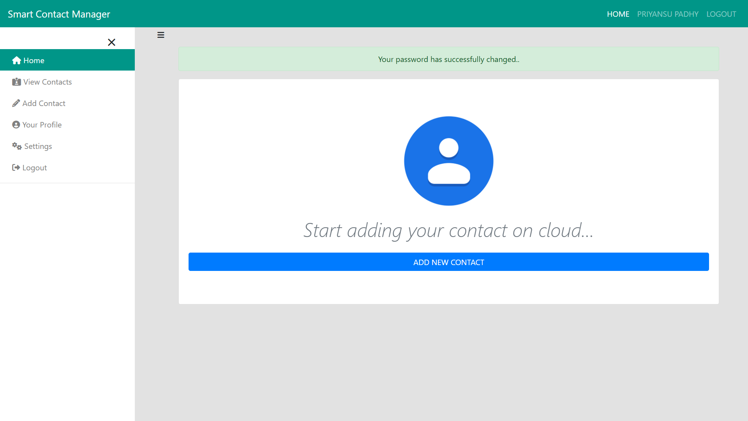
Screen Shots
Password Changed

Slide 25
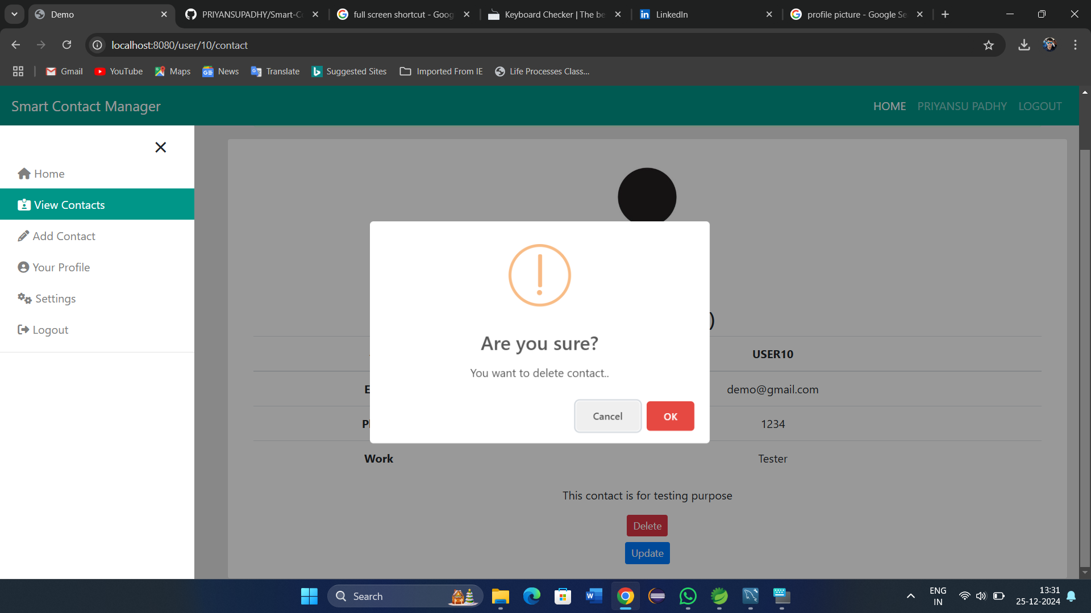
Screen Shots
Delete Contact

Slide 26
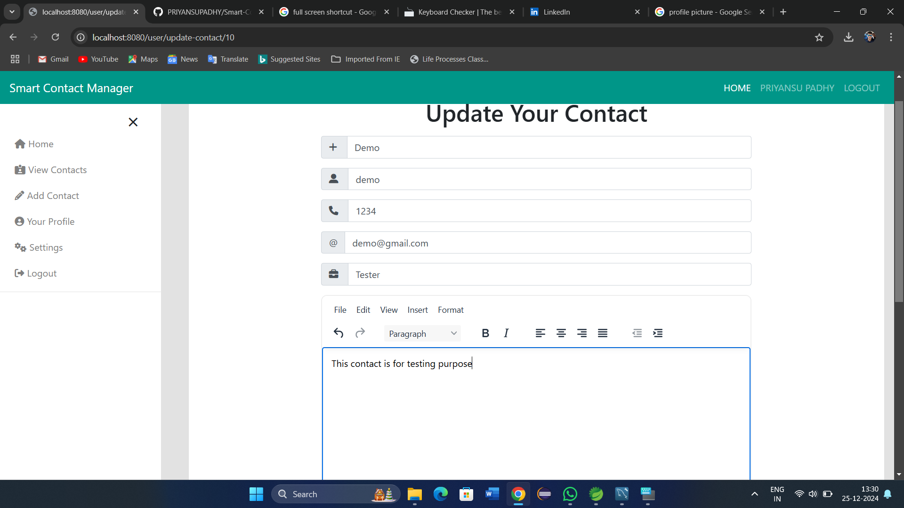
Screen Shots
Update Contact

Slide 27
Conclusion and Future Scope (Key Findings)
Conclusion:
The Smart Contact Manager offers a powerful solution for efficiently organizing and managing contact information. By leveraging modern technologies like Spring Boot, it ensures data security, scalability, and seamless integration with communication tools. With features such as automation, mobile access, and customizable interfaces, it enhances productivity, fosters better relationships, and addresses key challenges in traditional contact management systems. Overall, it provides a secure, user-friendly, and scalable approach to managing contacts in both personal and professional settings.
Future Scope:
AI Integration - Use AI for predictive insights and automated suggestions.
Voice Assistants - Enable integration with voice platforms for hands-free management.
Cross-Platform Integration - Integrate with more tools and social media platforms.
27

Slide 28
Bibliography
[1] Hands on Application Development using Spring Boot, Shagun Bakliwal, BPB Publication India.
[2] Software Engineering: A Practitioner’s Approach by Roger S. Pressman, McGraw-Hill Publication.
[3] Database System Concepts by Avi Silberschatz, Henry F. Korth and S. Sudarshan, McGraw-Hill Publication.
[4] Ahmed, M. T., & Sharma, P. (2019). Database Design for Inventory Management Systems. International Journal of Computer Applications, 15(3), 30-37.
[5] Bala, M. K., & Ponnusamy, S. (2021). Real-Time Inventory Management: Trends and Practices. Journal of Advanced Software Development, 8(4), 57-62.
[6]Introduction to Algorithms, Thomas H. Cormen, Charles E. Leiserson, Ronald L. Rivest, and Clifford Stein, MIT Press.
[7] Spring Boot Reference Documentation (v2.7). Spring Official Website.
URL: https://spring.io/projects/spring-boot

Slide 29

29

